Slide 1
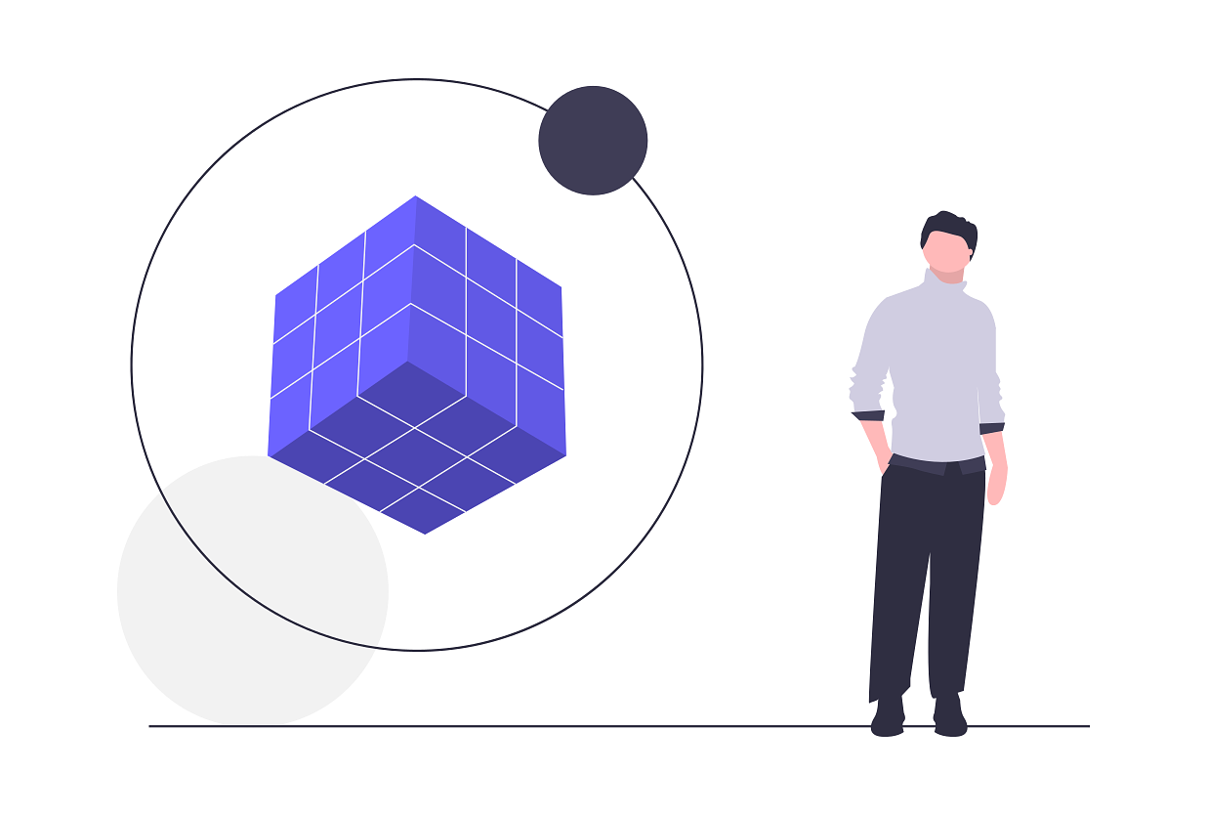
Problem Statement
Bringing the retail experience to consumers while simultaneously eliminating the middleman factor

Slide 3
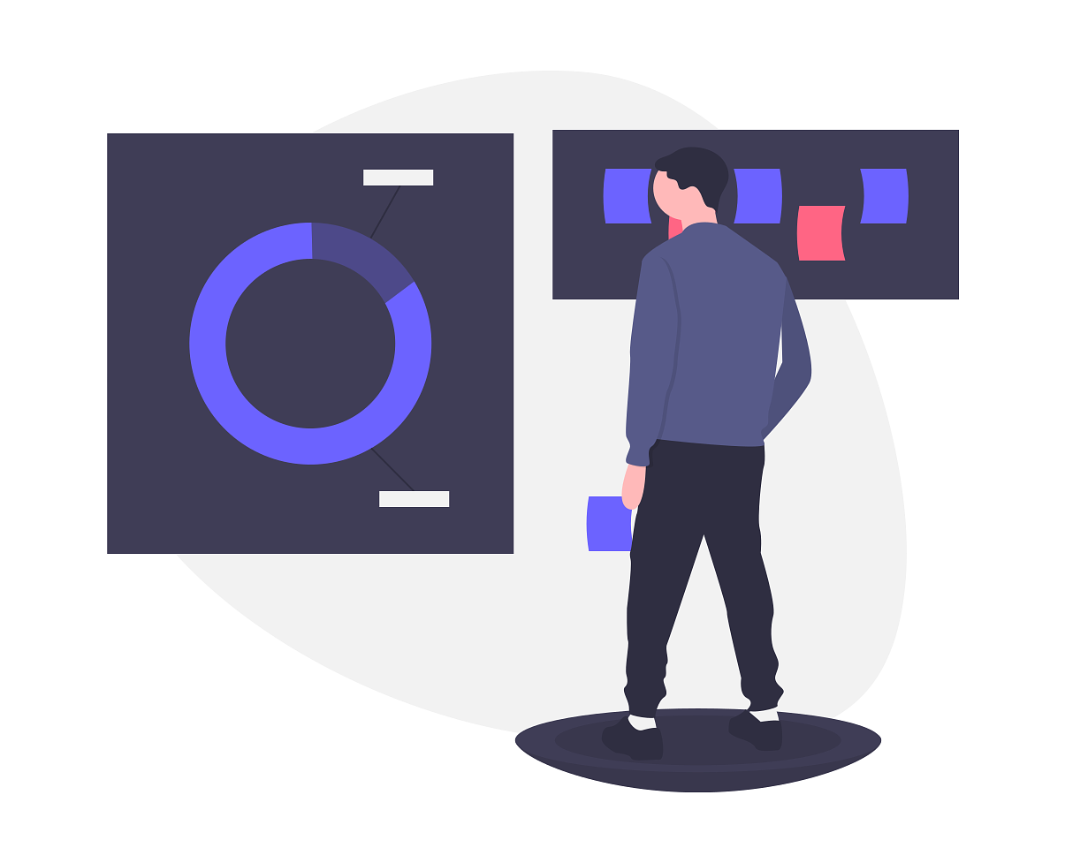
Efficiently connects consumers to manufacturers
Subscription based model for purchasing goods

Slide 4
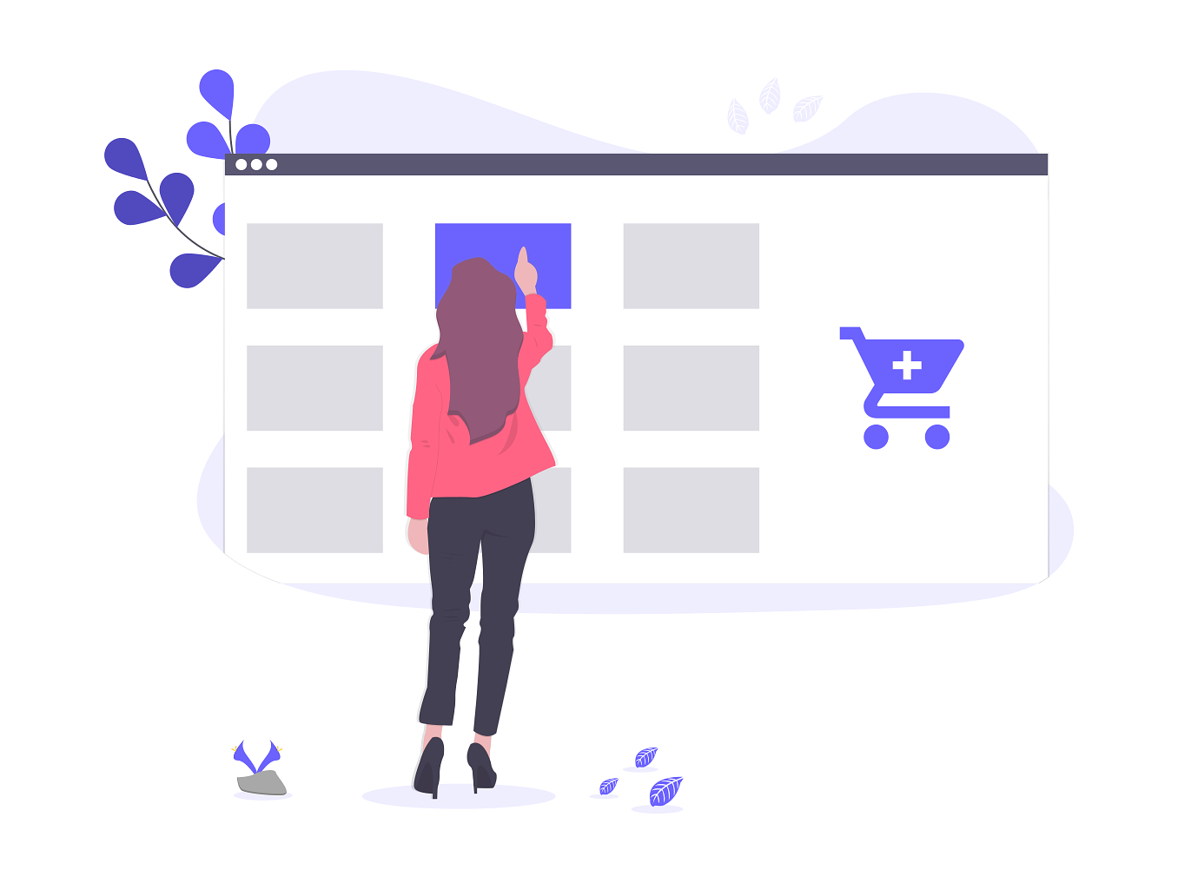
Users enroll on a subscription plan for the manufacturers products

Slide 5
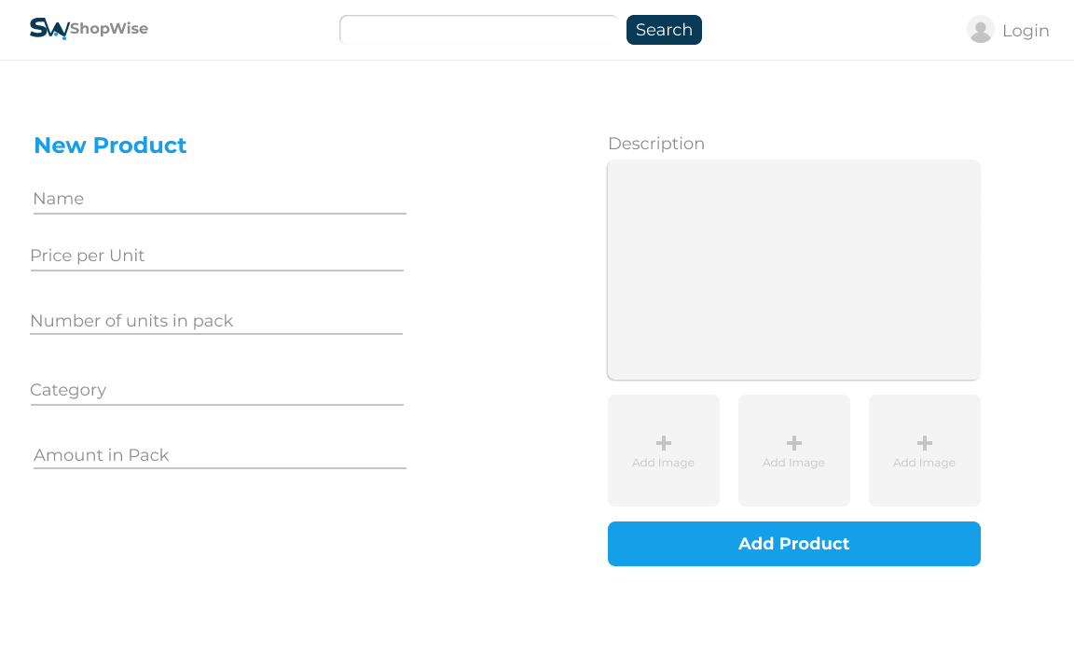
Notes:
Manufacturers page for adding products

Slide 6
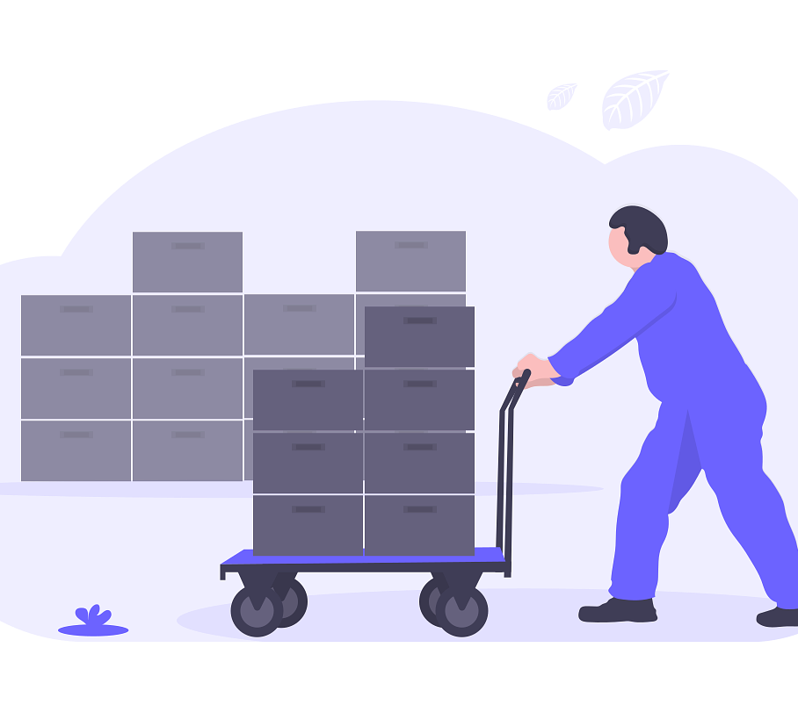
Consumers checkout goods on the cart and an api call is sent to a third-party logistics company for delivery

